Slide 1

Data Leakage
And How do we fight them
DATA 6545: Data Science & MLOps
Dr. Jie Tao
Fairfield Dolan

Slide 2
Train-test Split & Cross-Validation

Slide 3
Why Train-test Split?
Purpose of Training data
Purpose of Testing data
Point is this is unseen/NEW to the model
What’s a good ratio?
10 - 33% usually, depending on data size
100,000 data points is a good cut-off
Why use random_state?
To make sure we get the same split, so we don’t compare apples to oranges

Slide 4
Why Cross-Val?
When you use static train-test split, your model may:
Suffer from a bad draw (underfitting)
Overfit from a good draw
How to avoid that?
Let the model see different draws of data
Wait… but you just said the model cannot see ALL the data
That’s why we rotate the data (k-fold CrossVal)
Suppose k=10, every time you use 90% of the data (random sample) for training, and the remaining 10% for testing
Then we repeat it 10 times, to rotate through the data

Slide 5
Which one Should I do? Which one is Better?
Both. Neither.
They serve different purposes
Train-test split reserves a portion of the data which is new to the model => so that we can test the model generalizability
CrossVal lets the model see all the possible (TRAINING) data so no effect on selection bias
How do you do it then?
When getting a dataset, perform train-test split and keep the testing data UNTOUCHED ⇒ Sole use is to test the best model on new data
Perform Cross validation on the training data ONLY - the 10% or so become the validation set to help you select the best model

Slide 6
Why do we do them?
To avoid data leakage!

Slide 7
What is Data Leakage?

Slide 8
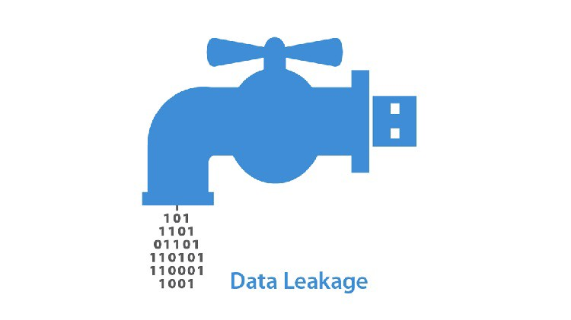
What is data leakage?
When the model sees thing it should not see
Future data points in a forecasting problem
Direct or calculation of the target in a predictive problem
What’s the big deal?
Serious overfitting problem
Your model learns things about the data
you are testing it against
Which will be unavailable when facing new, unseen data
Too generic, examples?

Slide 9
Example 1
Think about your project 1
C6’ is a variation of your target Y1 (all positive values and negative values of Y1 becomes 0)
So you cannot use it to predict Y1 - you can use it to predict Y2
Problem:
You cannot use the target, or its calculation, to predict itself

Slide 10
Example 2
Think about the following scenarios:
Can we use the scores of a basketball game to predict win/lose?
Can we use the grades for each deliverable in a course to predict pass/fail?
Problem:
You use them to calculate the target, so you cannot use them as predictors

Slide 11
Example 3- More Sophisticated
Think about scaling you do when preparing your data
For z-score scaling, you need to know the mean/standard deviation of the data
Problem
But if you use the global mean/standard deviation, that means you are including information about your TESTING set

Slide 12
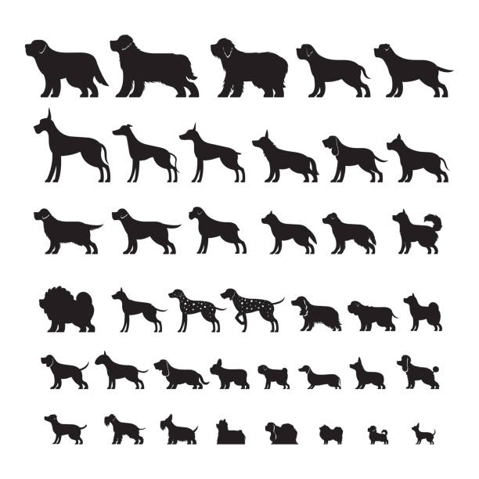

Example 4
What is the problem with the follow classification problem (dogs vs. cats)?

Slide 13

Example 4 - cont’d
How about this? (dogs vs. cats again)

Slide 14
How to detect Data Leakage

Slide 15
Generic Rules
If the results is too good to be true, it is NOT true
If you see a nearly perfect model, think again
Correlation helps.
During your EDA, if a feature is very highly correlated with your target, think about whether to use it
Rule of thumb: >=90%
Feature importance helps, too.
Once complete training your initial model, look at feature importance. Very highly important features might be fishy
Background/Domain knowledge is important
E.g., if a patient went through a certain procedure, it may relate to the severity of a certain disease.

Slide 16
Other Causes
Preprocessing: scaling, PCA, …
Duplicates between your training and testing data
Temporal relationships: using future/unknown data to train the model
Inappropriate problem design/statement

Slide 17
How to battle Data Leakage

Slide 18
Techniques that to be considered/implemented
Hold out a set for testing - do not touch it in any preparation/modeling stages
Set the target feature aside - do not touch it in data prep, and feature engineering
Perform cross validation on the training data
Remove leaky features using EDA results
Always compare training vs. testing results: big overfitting can be signs of leakage

Slide 19
Other Techniques to be Considered
Temporal cutoff: set up a time spot and only use the data prior to it
Add noise to your data: making the learning/training process harder
Use pipelines: pipelines are predefined steps in analyses, use them to avoid ad-hoc errors/biases
Limit the application of the models: only apply it to the problems similar to the one you trained it on

Slide 20
References (If you want to Learn More)
https://machinelearningmastery.com/data-leakage-machine-learning/
https://machinelearningmastery.com/data-preparation-without-data-leakage/
https://www.analyticsvidhya.com/blog/2021/07/data-leakage-and-its-effect-on-the-performance-of-an-ml-model/
https://towardsdatascience.com/data-leakage-in-machine-learning-how-it-can-be-detected-and-minimize-the-risk-8ef4e3a97562
https://towardsdatascience.com/data-leakage-in-machine-learning-10bdd3eec742

